Slide 1

THEME : ONLINE EDUCATION
HACKATHON
MADE BY:-
TEAM: HUNGER HACKER
DHRUMI SHAH
ARYA SHAHI

Slide 2
AIM:-
One of the major problems in this COVID-19 pandemic is to make online education more COMFORTABLE,INTERACTIVE and EFFECTIVE.
Our aim is to develop a website to do the same.

Slide 3

PROBLEM:-
In this COVID-19 pandemic with everyone locked up at their homes, student’s life has become miserable.
Whether it be looking out for books or setting short term goals to achieve desired success or it be handling boring online classes or preparing for exams! Now there is no need to scratch head looking for such solutions , our website will solve them all!

Slide 4

PROBLEM(LIBRARY):-
In offline library, one can issue a limited number of books for limited amount of time.
One has to finish reading those books in that limited time.
Sometimes, books in the library are found in miserable condition.
If one needs to buy that book for future use, it might be expensive for an individual.
One also needs to give penalty for delay submission.

Slide 5
SOLUTION(LIBRARY):-
Going to library, searching for books, giving penalty for delay submission now won’t be an issue as our website will provide with variety of books from their curriculum to the books with their field of interest.
One can get access to these books just by few clicks! Without spending a penny.
One can use it anytime, anywhere from any corner of the world!

Slide 6

PROBLEM(TO-DO LIST)
In this adverse situation, it has become more difficult for a student to concentrate on studies to fulfill desired results.
Sometimes due to much workload, one might forget to complete some portion of their work.

Slide 7
SOLUTION(TO-DO LIST)
One can make his/her day more scheduled to get closer to their goals, step by step with TO-DO LIST.
It helps in planning and organizing for smooth execution.
It helps in reminding of deadlines.
It helps to remember all the tasks one needs to perform.

Slide 8

PROBLEM(NOTES):-
Student’s best friend during exam time are notes!
It becomes difficult to search for notes during exams.
One has to complee vast syllabus in very short period of time.

Slide 9
SOLUTION(NOTES):-
Now searching for notes from friends during exam won’t be an issue as, this website might come to their rescue!
Through this website one can prepare their own notes and may save them for their future use.

Slide 10

FEATURES:-
This website will be equipped with following features:
Online library
TO-DO List
Notes

Slide 11
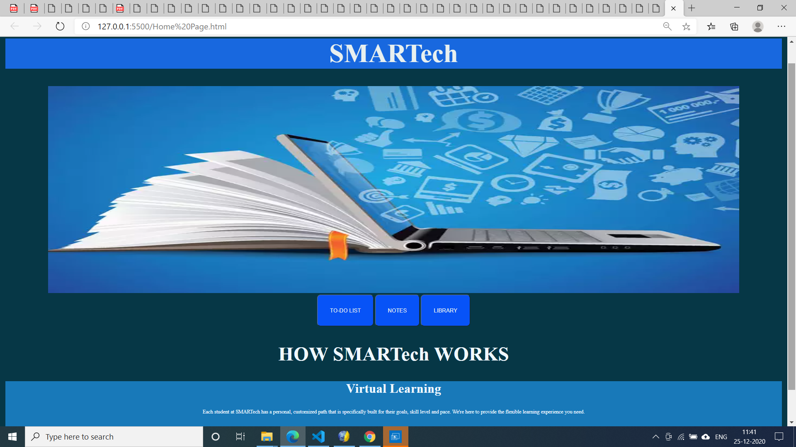
Website Preview

Slide 12
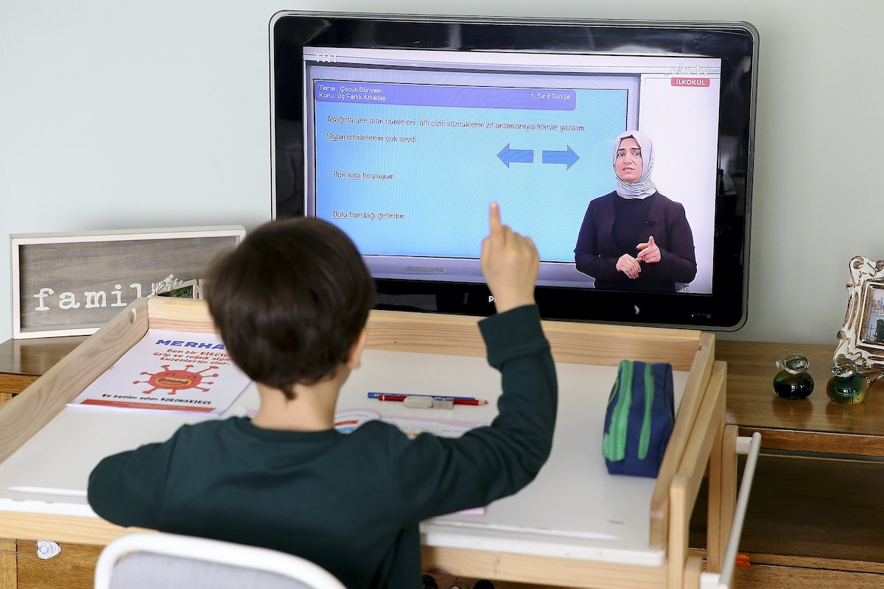
In a nutshell we will try to make online education,
COMFORTABLE, INTERACTIVE and EFFECTIVE.

Slide 13


THANK YOU
This Photo by Unknown Author is licensed under CC BY-NC
This Photo by Unknown Author is licensed under CC BY-SA-NC

